Slide 1

Z Energy Project - Phase 1 Overview
Enhancing the Station Locator and Fuel Price Features.
Special Team

Slide 2
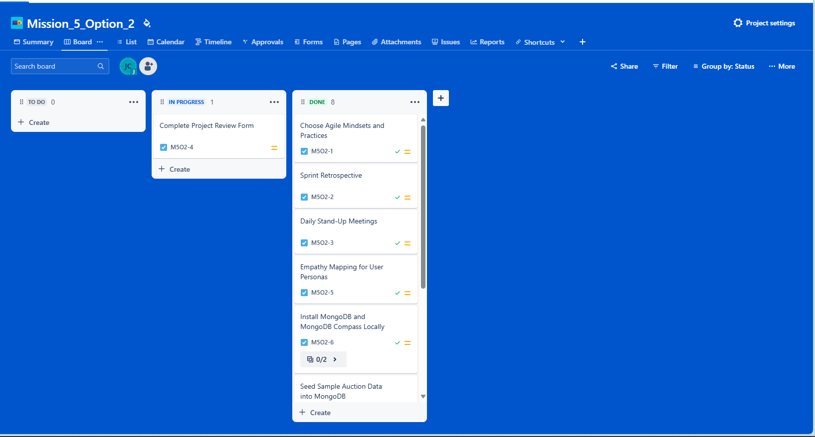
Task 1: Managing Team Tasks with Jira
Objective:
Set up a shared Jira board to manage tasks collaboratively.
Columns:
"To-do", "In-progress", "Done".
High-Level Tasks:
Main tasks and sub-tasks are added and updated by team members.
Mission_5_Option_2
Notes:
We organised our Jira board with "To-do", "In-progress", and "Done" columns, breaking tasks into smaller sub-tasks. This helped track progress, prioritise work, and maintain accountability within the team, ensuring smooth collaboration throughout the project. Here's a screenshot/demo of our Jira board to show how we managed tasks.

Slide 3
Task 2: Daily Stand-Up Meetings
Objective: Perform daily 15-minute stand-ups to track progress.
Focus Points:
What was done yesterday?
What will be done today?
Are there any blockers?
Tools:
Daily updates are added to Jira to track blockers.
Visuals:
Screenshot or table showing start and end times of daily stand-ups.
Key Points:
Stand-ups foster quick problem resolution.
Blockers are identified and addressed.
Agile Document for Mission 5
Notes:
Daily Stand-ups Summary throughout the mission, we conducted daily stand-up meetings to review progress and tackle any blockers. A significant issue arose with the integration of the Google Maps API, which was successfully resolved through collaborative effort. You can access the full transcript of our daily stand-up discussions and resolutions here.

Slide 4
Task 3: Agile Mindsets and Practices
Chosen Agile Values:
Individuals and Interactions Over Processes and Tools.
Responding to Change Over Following a Plan.
Agile Practices:
Daily Stand-Ups.
Sprint Retrospectives.
Test-driven Development.
Design Thinking:
Empathy Mapping for User Personas.
Agile Document for Mission 5
Notes:
"Our team embraced Agile values by prioritizing 'Individuals and Interactions Over Processes and Tools' and 'Responding to Change Over Following a Plan.' This was evident in our collaboration with UX designers, where we participated in design discussions to ensure technical feasibility and alignment with user needs. By applying 'Empathy Mapping' from Design Thinking, we gained a deeper understanding of user personas, which guided our decision-making throughout development. We further embraced Agile practices like Sprint Retrospectives and Test-Driven Development to ensure continuous improvement and adaptability as we progressed.

Slide 5
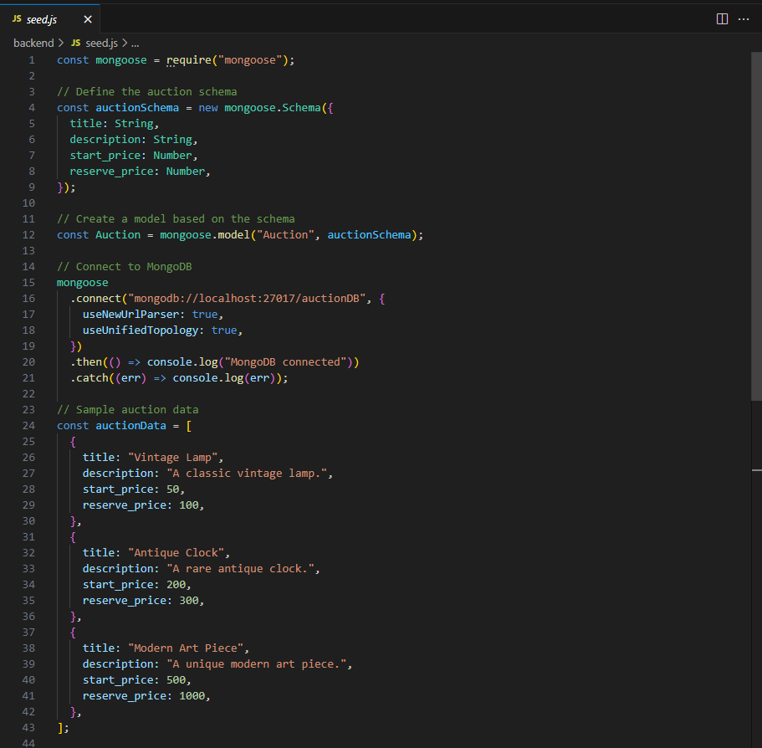
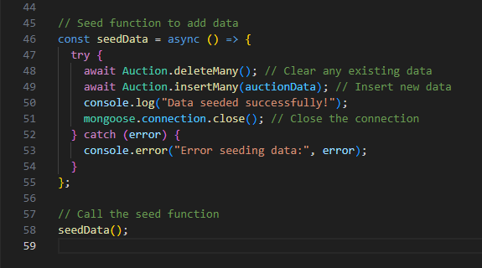
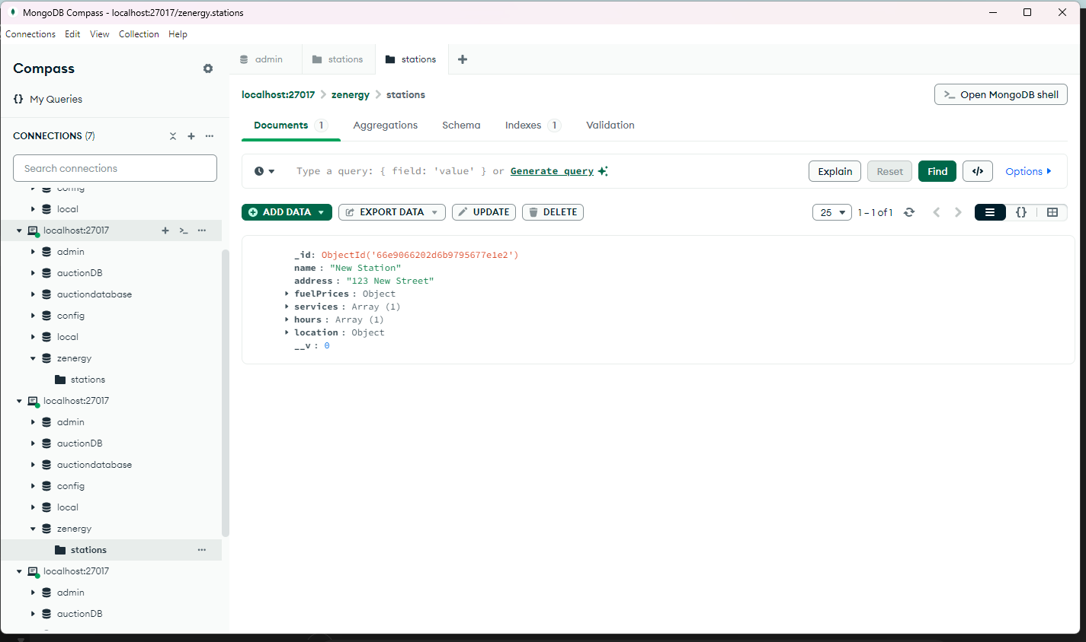
Task 4: Setting Up MongoDB Locally
Objective:
Install MongoDB and MongoDB Compass for local database management.
Command:
npm install mongoose
Files:
Seed.js: Seeding script for MongoDB.
Notes:
We set up MongoDB and MongoDB Compass locally, installing all necessary dependencies like Mongoose.

Slide 6
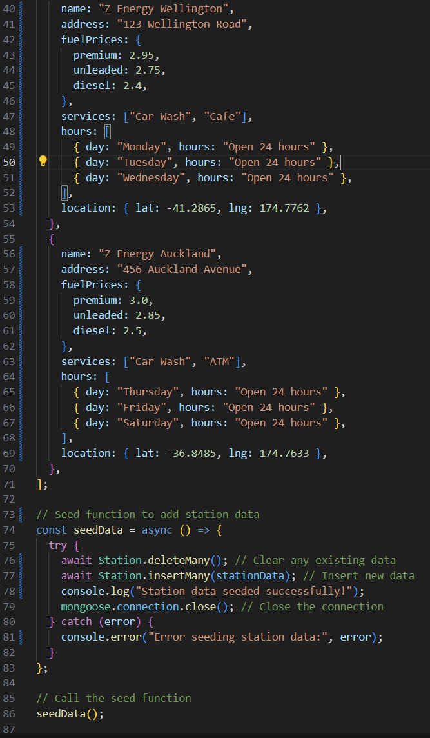
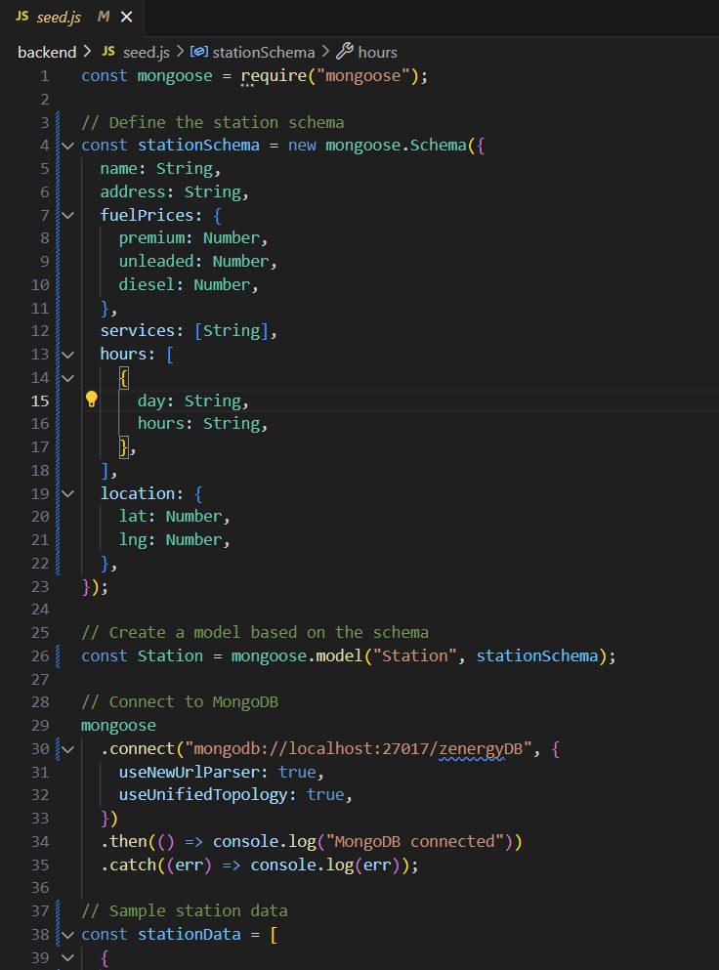
Task 5: Seeding Auction Data into MongoDB
Objective:
Create a CLI tool to seed and delete auction data.
Files:
Seed.js
Notes:
After the installation, we created a seeding tool (seed.js) to populate our local database with auction data, including fields like title, description, start price, and reserve price. This ensured that our database was pre-loaded with the necessary data to perform further tasks.

Slide 7
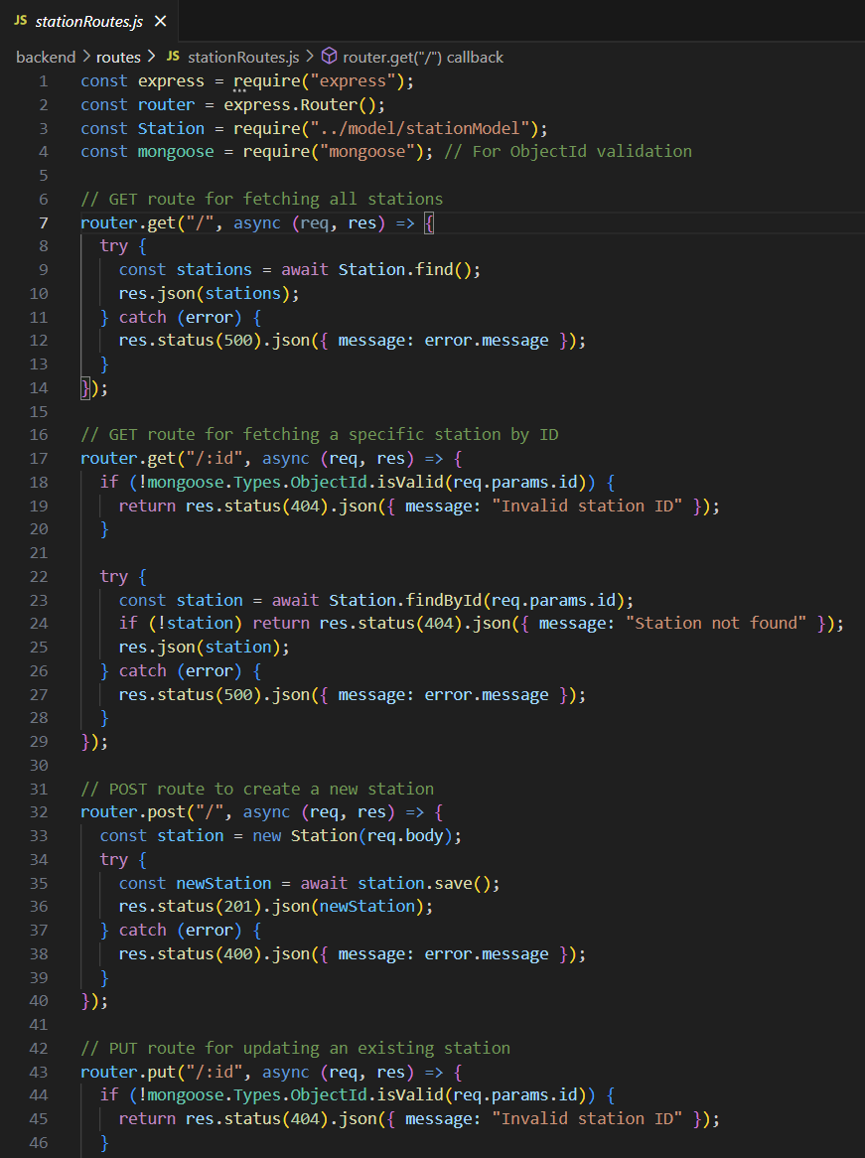
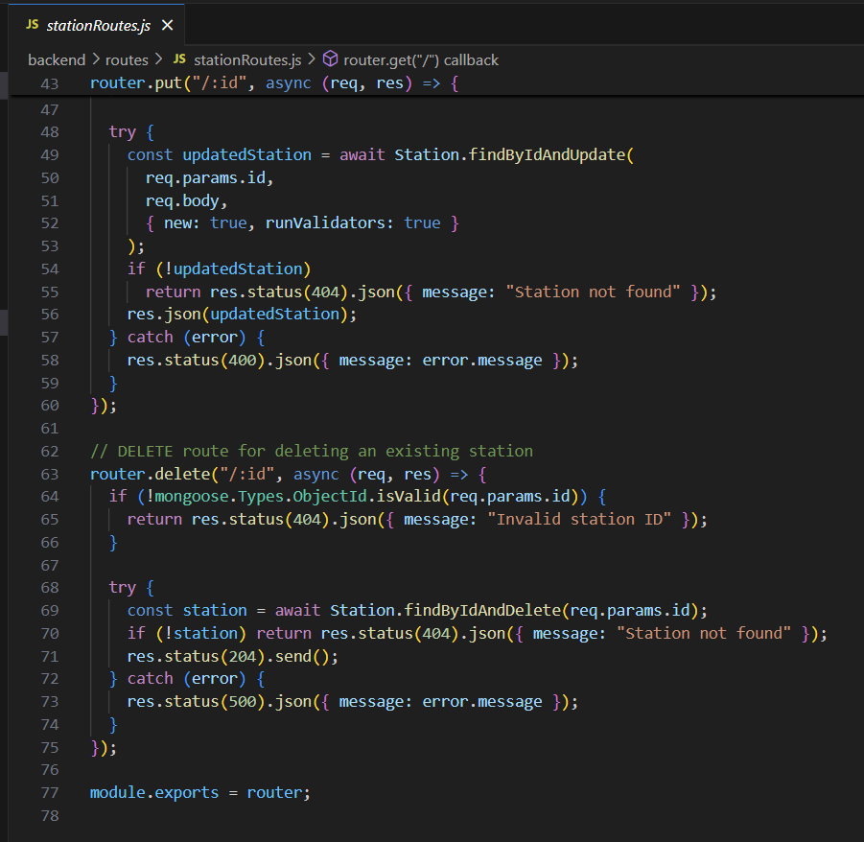
Task 6: API for Displaying Station Items
Objective:
Create an API to retrieve stationroutes from MongoDB.
Files:
stationRoutes.js
Notes:
This code defines API routes for managing station data in a MongoDB database using Mongoose in a Node.js/Express application. The routes include:
GET all stations or a specific station by its ID.
POST to create a new station.
PUT to update an existing station by its ID.
DELETE to remove a station by its ID.
Validation checks ensure valid station IDs, and error handling responds with appropriate status codes for failed operations. This structure allows full CRUD (Create, Read, Update, Delete) functionality for station data.

Slide 8
Task 7: Feasibility Input for UX Design
Objective:
Provide technical input to the UX Designers on the feasibility of the prototype designs.
As developers, we reviewed the proposed designs and identified potential technical
limitations or areas that could be optimized for performance or usability.
We provided feedback on components such as the map integration and real-time
updates, ensuring they could be built efficiently within the project's timeframe and with the given tools (e.g., MongoDB and React).
Our Role:
Key Inputs Provided:
Map Integration: Advised on the feasibility of integrating the Google Maps API to
display nearby fuel stations.
Data Retrieval: Suggested adjustments in the prototype to accommodate the data
fetching process for auction items from MongoDB. Z Energy - Figma

Slide 9
Task 8: Prototype Design Walkthrough
Objective:
Attend the walkthrough organized by the UX Designers and clarify any uncertainties related to the design.
Our Role:
We participated in the design walkthrough session to better understand the user
flows and design decisions.
During the walkthrough, we asked questions related to the technical details, such
as how data would be presented in the fuel station search and auction items.
Key Takeaway:
The design focused on improving user experience through intuitive search
functionalities.
We clarified the integration of the Google Maps API and how auction data would be
retrieved from MongoDB and displayed. Z Energy - Figma

Slide 10
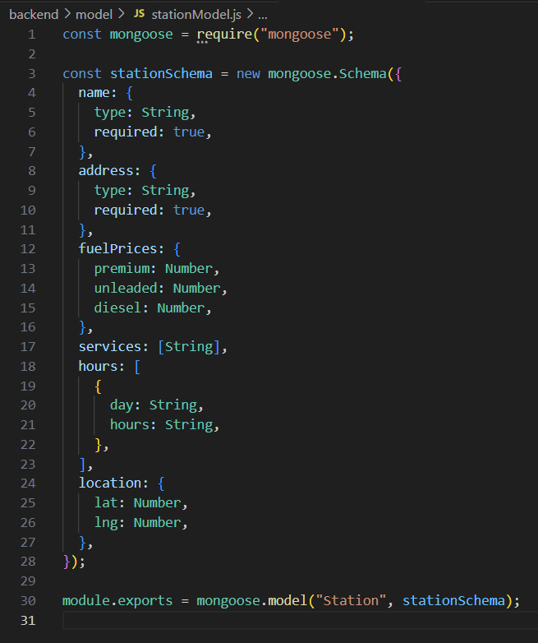
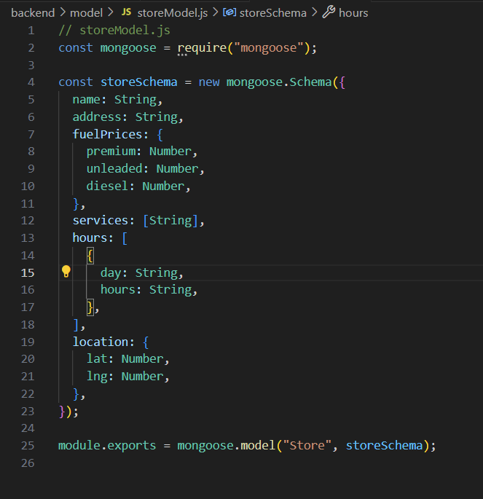
Backend Development
The backend was set up using Node.js and Express, while MongoDB was used to store data about auction items, fuel stations, and store details.
Key Highlights:
Data Models: Defined models using Mongoose for stations (stationModel.js), and stores (storeModel.js), allowing structured data management in MongoDB.
Notes:
Stationmodel: Explanation:
This schema defines the structure of each fuel station, including the name, address, fuel prices, available services, operating hours, and location (latitude and longitude).
Storemodel: Explanation:
The store model shares a similar structure with stations but is specifically tailored for stores, with details about services, hours, and location.

Slide 11
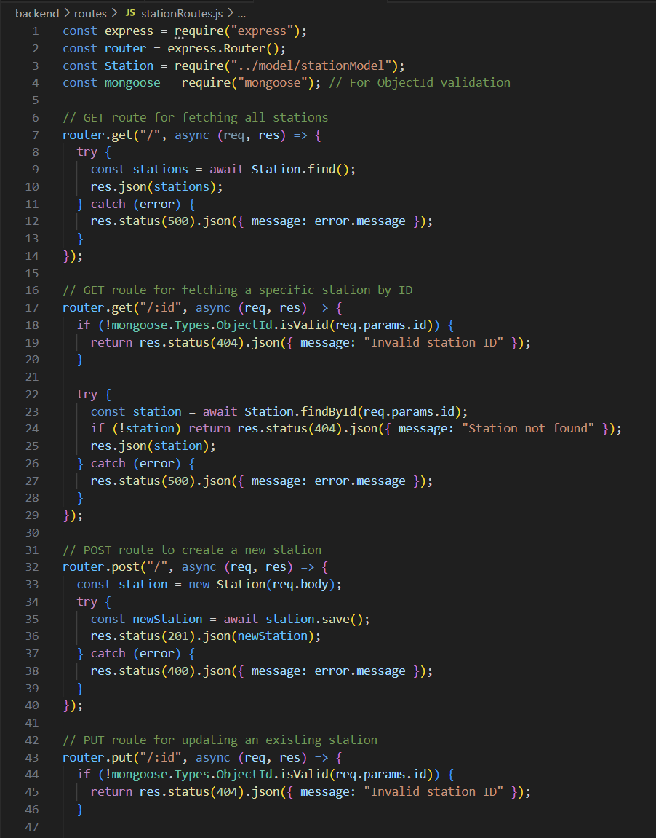
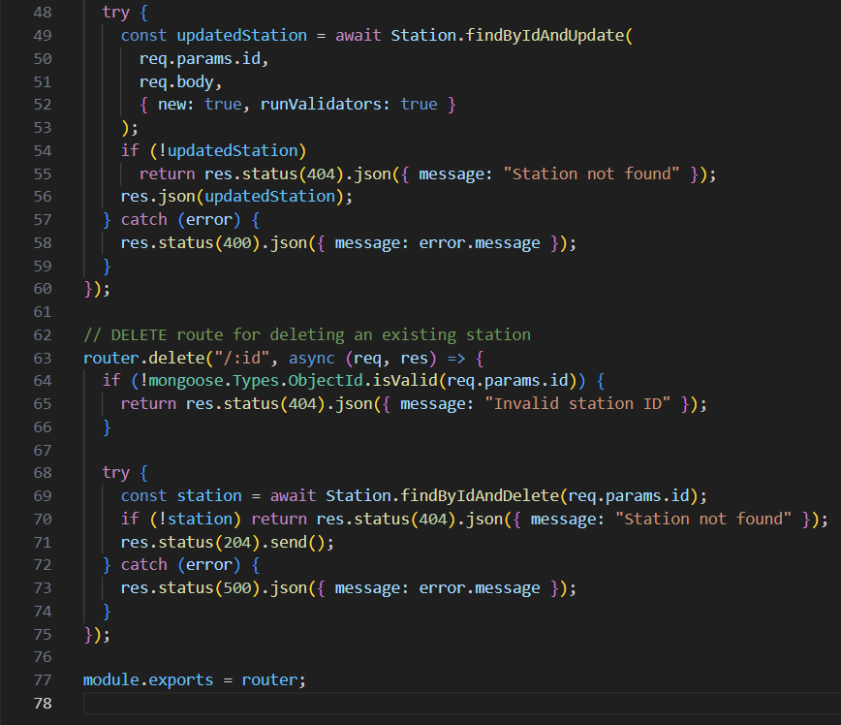
Backend Development
The backend was set up using Node.js and Express, while MongoDB was used to store data about auction items, fuel stations, and store details.
Key Highlights:
API Development: Implemented RESTful API endpoints for performing CRUD operations on fuel stations and auction items. These include creating, reading, updating, and deleting records (CRUD).
Station Routes (stationRoutes.js): Allows fetching, adding, updating, and deleting station information.
Notes:
In this backend setup, we developed a robust API using Node.js, Express, and MongoDB to manage fuel stations and auction items. One of the key features is the CRUD operations (Create, Read, Update, Delete), which allow seamless interaction with the MongoDB database.
For instance, the stationRoutes.js handles operations like fetching all stations, retrieving specific stations by ID, and updating or deleting station records. Additionally, a search route in the auctionRoutes.js enables keyword-based searches for auction items, offering dynamic results for users. What’s particularly interesting is how we leveraged Mongoose to structure our data models for stations, auctions, and stores, which ensures clean and organized data management throughout the application.

Slide 12
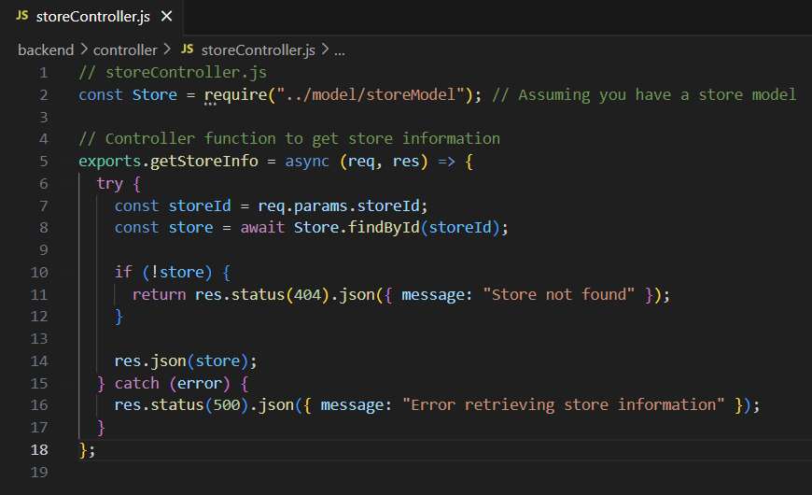
Backend Development
The backend was set up using Node.js and Express, while MongoDB was used to store data about auction items, fuel stations, and store details.
Example Code:
The Store Controller (storeController.js) handles fetching store information based on a store ID, returning store data like fuel prices and services.
Notes:
This code retrieves store data by storeId, which includes important information like fuel prices, services, and location details. If the store is not found, it returns a 404 error.

Slide 13
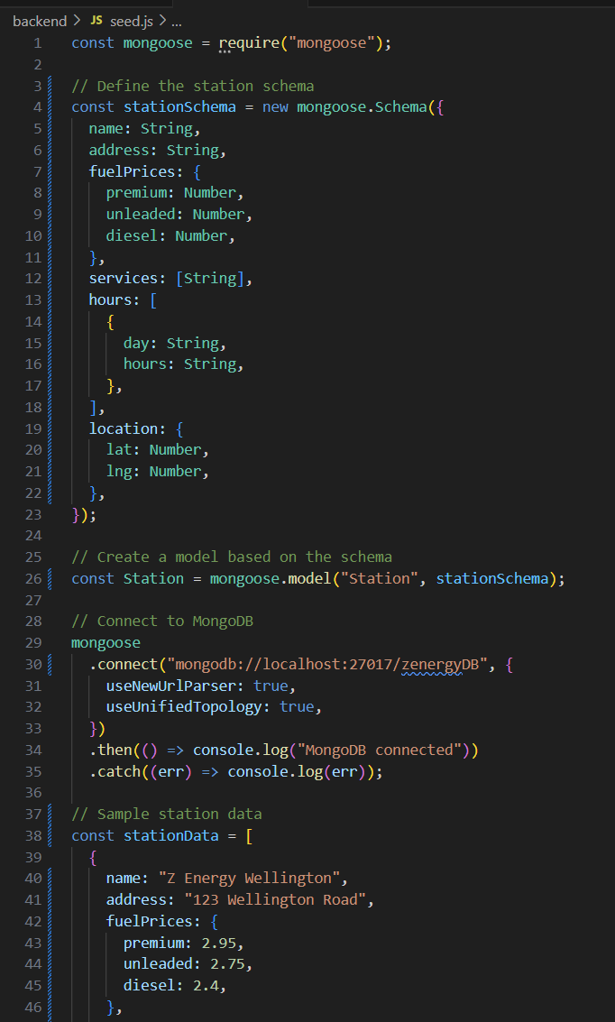
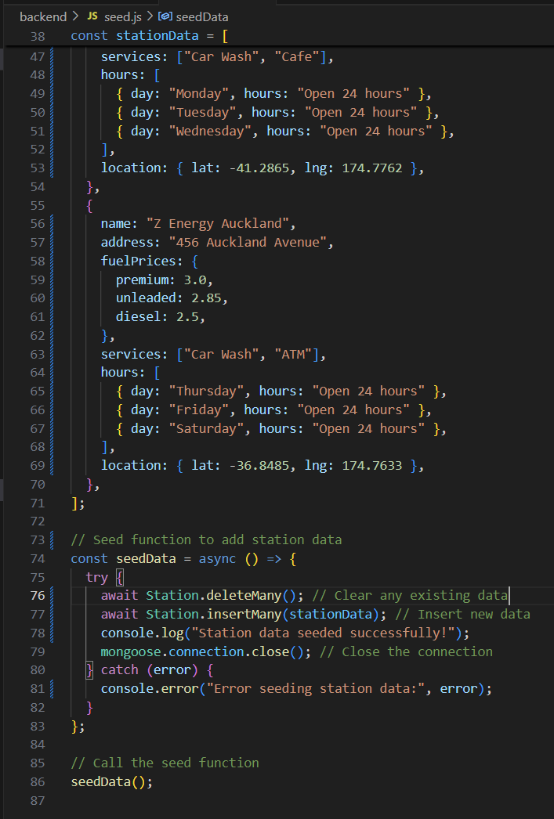
Backend Development
Seeding Data
The application includes a seeding script (seed.js) to populate the database with initial data for both auction items and fuel stations. This script is essential for testing and providing demo content.
Key Notes for Seeding:
Station data was also seeded, including fuel prices, services, and location information, which is crucial for the station locator.
Notes:
Key Points:
Station Schema Definition:
The schema (stationSchema) defines the structure of the data for each station, including the station's name, address, fuel prices (premium, unleaded, diesel), services (e.g., car wash, cafe), opening hours, and geographic location (latitude and longitude).
MongoDB Connection:
The code connects to a local MongoDB instance with the database named zenergyDB. If the connection is successful, it logs "MongoDB connected"; otherwise, it logs an error.
Sample Data:
The stationData array contains sample data for two fuel stations, each with relevant details like fuel prices, services offered, and location.
Seeding Function:
The seedData function first deletes any existing station data using Station.deleteMany().
It then inserts the new sample data from stationData using Station.insertMany().
Once data is seeded successfully, it closes the database connection.

Slide 14
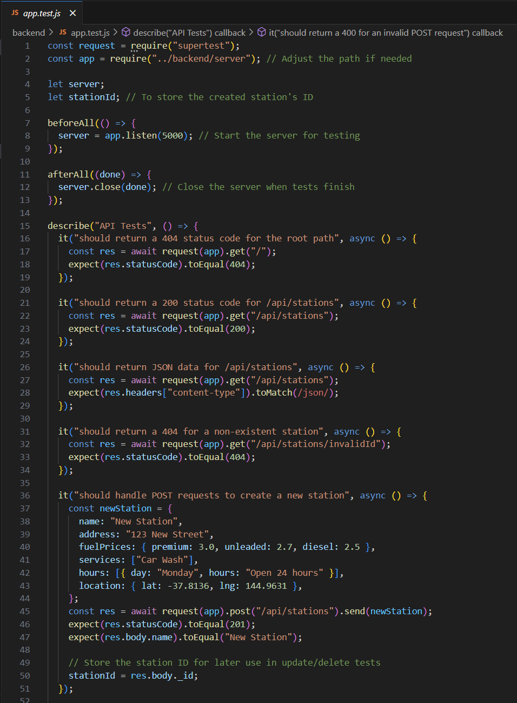
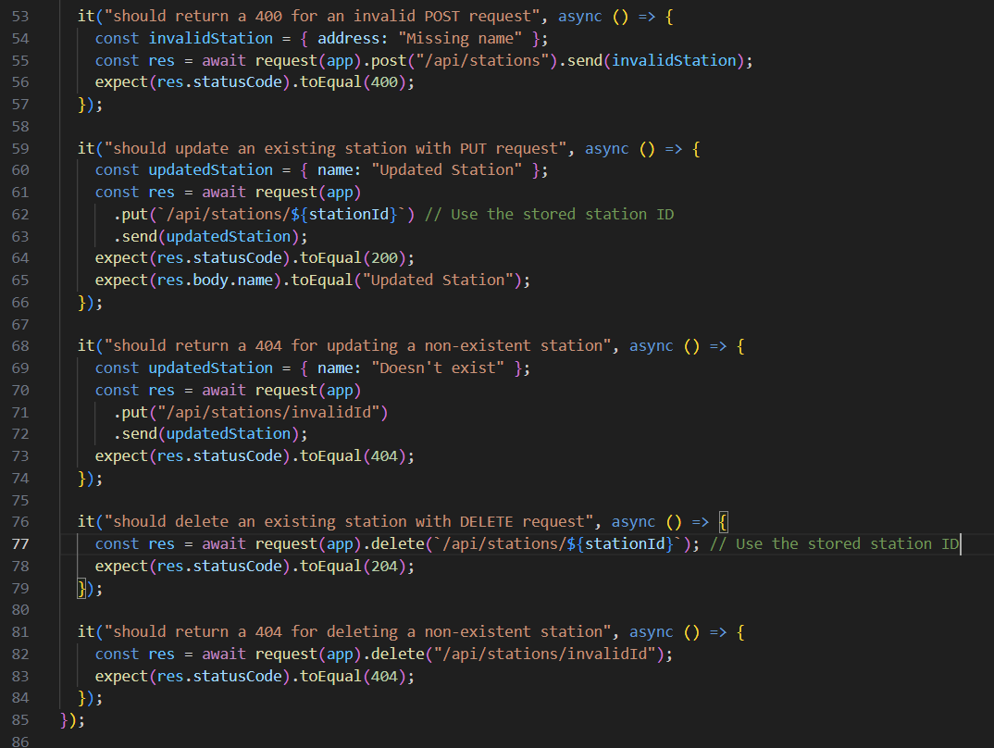
Backend Development
App.test.jx
Example Code Highlights:
Supertest is used to simulate HTTP requests to the API.
The tests validate different routes (GET, POST, PUT, DELETE) for stations, ensuring API functionality.
It checks edge cases like invalid station IDs and malformed data for robustness.
Notes:
This code snippet demonstrates the implementation of unit tests for the backend API using Supertest and Jest. The tests focus on CRUD operations for fuel stations, validating the proper behavior of the API endpoints. It tests for various scenarios, such as fetching all stations, handling invalid station IDs, creating new stations via POST, and updating or deleting stations. The key highlights include handling different HTTP status codes (e.g., 404 for non-existent stations, 201 for successful POST requests) and testing JSON responses. This ensures the backend functions correctly before deployment.

Slide 15
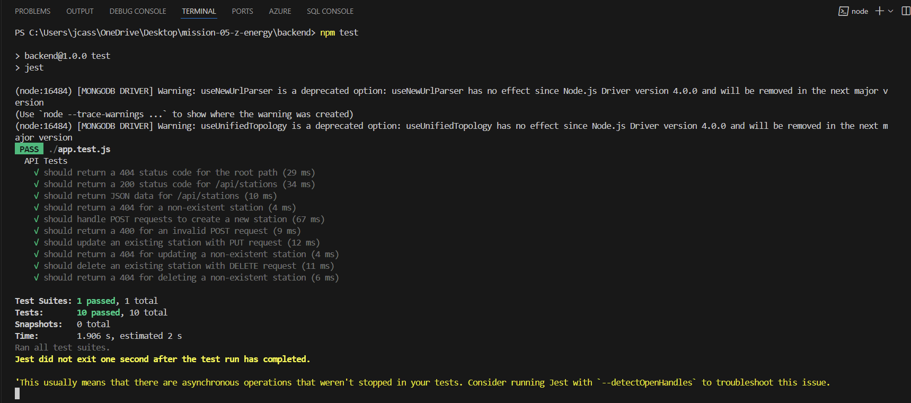
Backend Development
App.test.jx
Npm test Highlights:
Supertest is used to simulate HTTP requests to the API.
The tests validate different routes (GET, POST, PUT, DELETE) for stations, ensuring API functionality.
It checks edge cases like invalid station IDs and malformed data for robustness.
Notes:
This code snippet demonstrates the implementation of unit tests for the backend API using Supertest and Jest. The tests focus on CRUD operations for fuel stations, validating the proper behavior of the API endpoints. It tests for various scenarios, such as fetching all stations, handling invalid station IDs, creating new stations via POST, and updating or deleting stations. The key highlights include handling different HTTP status codes (e.g., 404 for non-existent stations, 201 for successful POST requests) and testing JSON responses. This ensures the backend functions correctly before deployment.

Slide 16
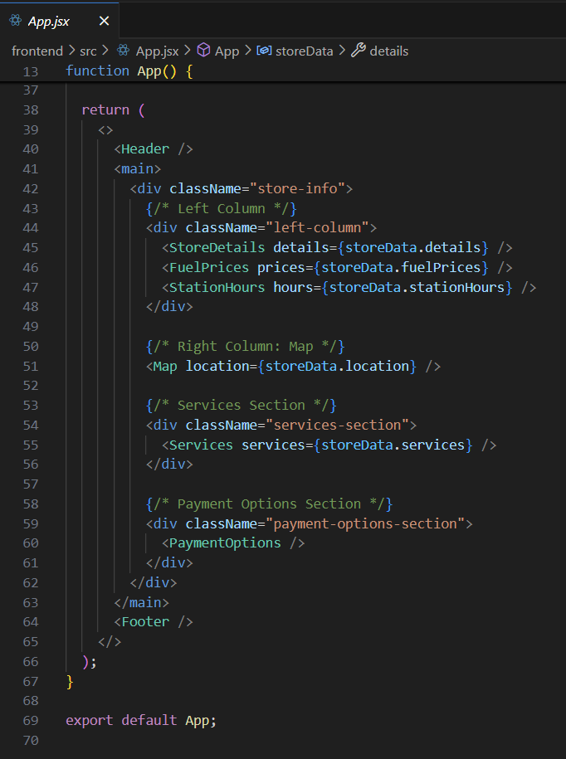
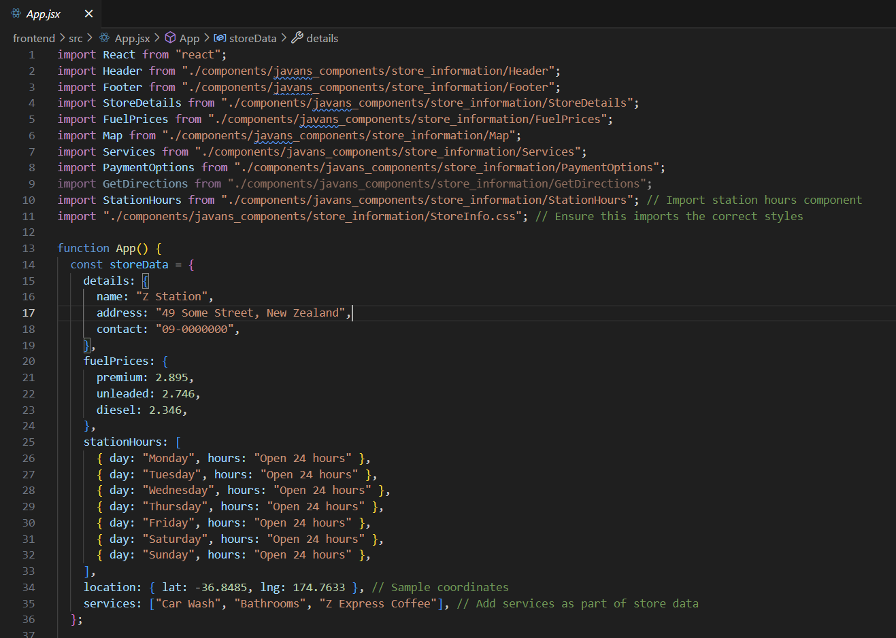
Frontend Development
Once the backend API was established, the frontend used React components to interact with the MongoDB database via the API.
Key Highlights:
App.jsx:
This is the main entry point for the store information page. It imports several components like Header, StoreDetails, FuelPrices, Map, Services, PaymentOptions, and StationHours.
Notes:
Explanation: The App component provides mock store data and passes it as props to child components for display. Components like StoreDetails, FuelPrices, StationHours, Map, Services, and PaymentOptions are used to build the store information layout.

Slide 17
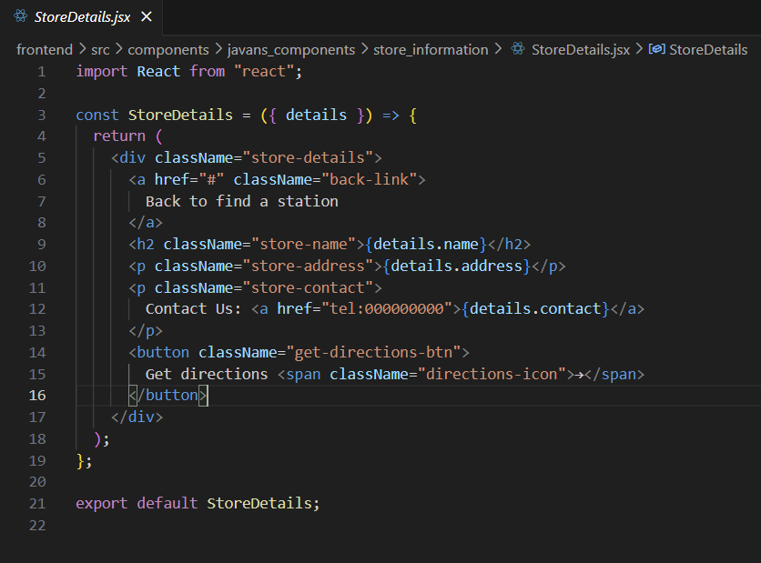
Frontend Development
Once the backend API was established, the frontend used React components to interact with the MongoDB database via the API.
Key Highlights:
StoreDetails.jsx:
This component displays the basic store details, including the store name, address, and contact information.
Notes:
Explanation: StoreDetails takes in a details object and displays the store’s name, address, and contact information, along with a button to get directions.

Slide 18
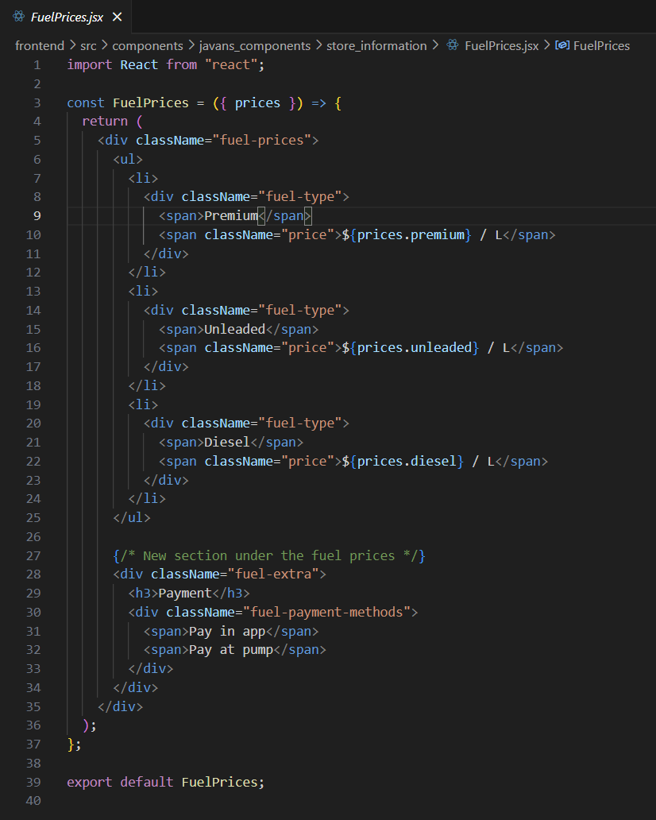
Frontend Development
Once the backend API was established, the frontend used React components to interact with the MongoDB database via the API.
Key Highlights:
FuelPrices.jsx:
This component handles the display of fuel prices for different fuel types (Premium, Unleaded, Diesel).
Notes:
Explanation: FuelPrices takes a prices prop and dynamically displays the fuel prices for Premium, Unleaded, and Diesel in a structured format.

Slide 19
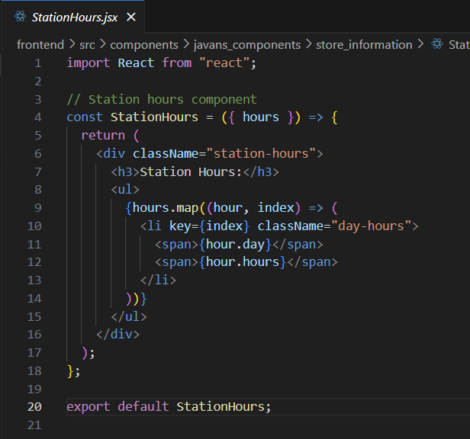
Frontend Development
Once the backend API was established, the frontend used React components to interact with the MongoDB database via the API.
Key Highlights:
StationHours.jsx:
This component lists the operational hours of the station.
Notes:
Explanation: StationHours accepts an array of hours as a prop and maps over it to display each day and the corresponding hours of operation.

Slide 20
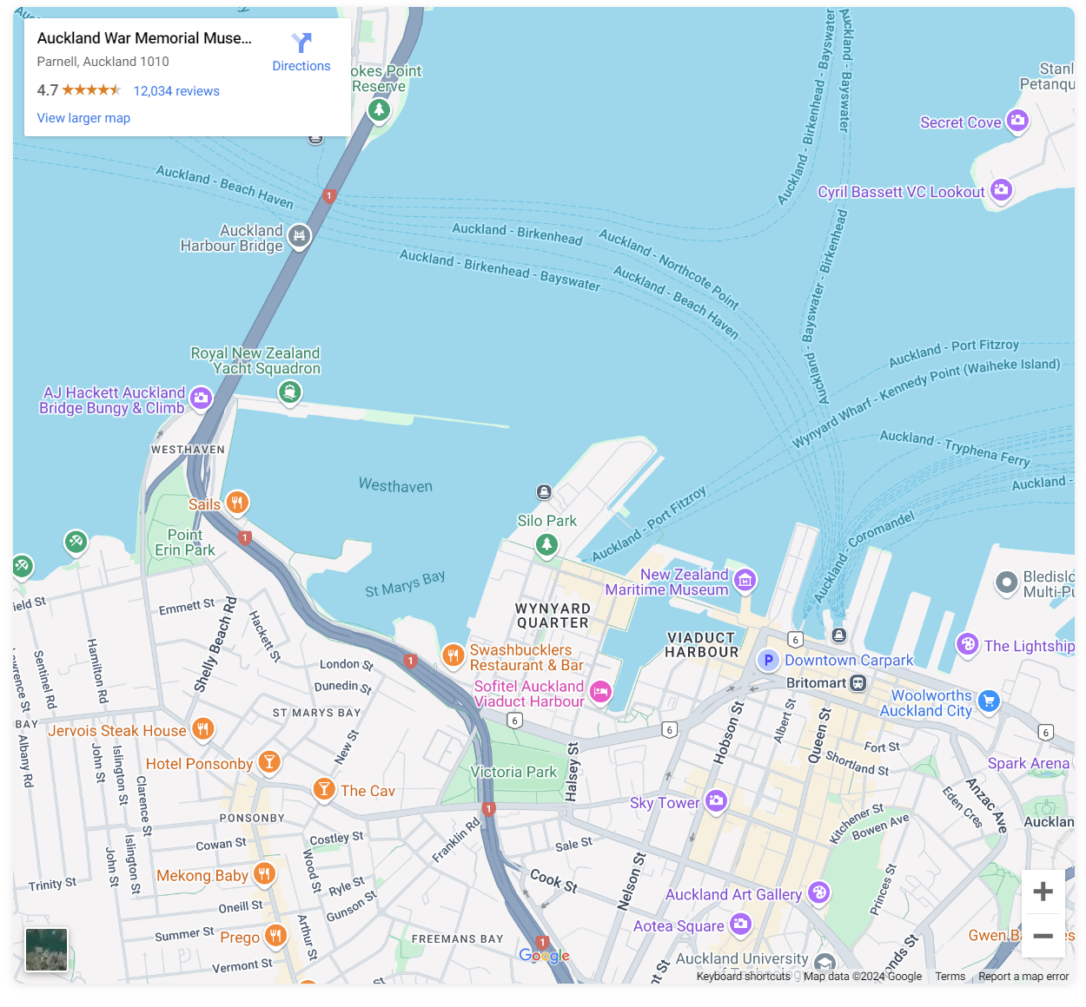
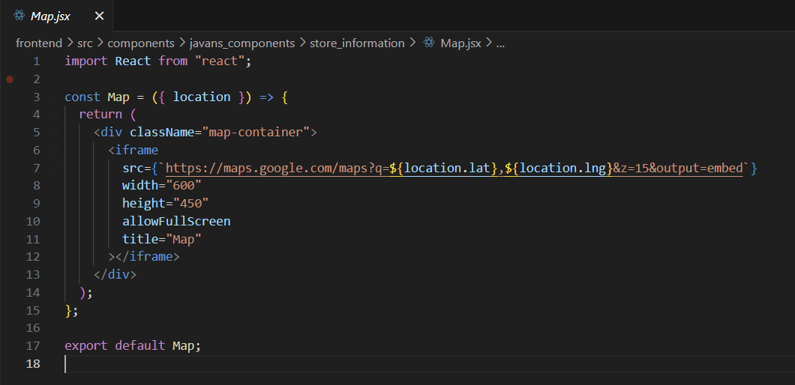
Frontend Development
Once the backend API was established, the frontend used React components to interact with the MongoDB database via the API.
Key Highlights:
Map.jsx:
This component uses an embedded Google Map to display the store’s location.
Notes:
Explanation: Map uses Google Maps' embed feature, passing in the latitude and longitude from the location prop to display a map centered on the store's coordinates.

Slide 21
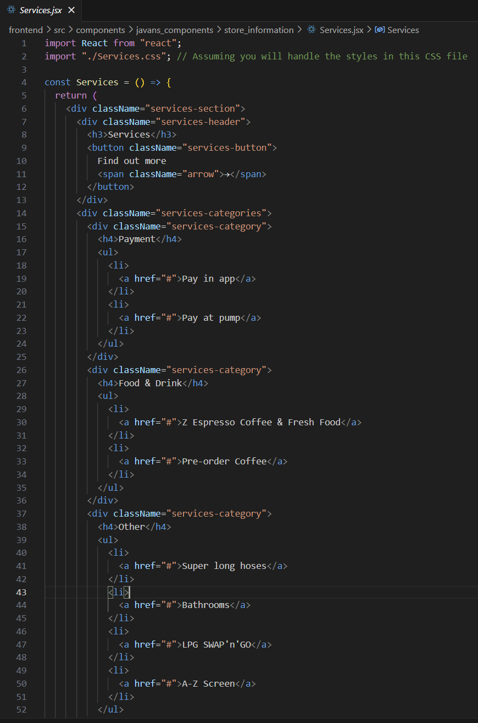
Frontend Development
Once the backend API was established, the frontend used React components to interact with the MongoDB database via the API.
Key Highlights:
Services.jsx:
This component lists the various services offered at the station, such as Car Wash or Z Express Coffee.
Notes:
This React component, Services, renders a section of the store page that lists the various services offered by the station, such as payment methods, food and drink options, and additional amenities like bathrooms and LPG SWAP'n'GO. The component is structured with a header, a button for more information, and categorized lists of services. Each category (e.g., "Payment", "Food & Drink", "Other") includes relevant service links, providing an organized, user-friendly interface for customers. The accompanying CSS file (Services.css) handles the styling of the component.

Slide 22
Thank you

